Slide 1
1.6: Understanding The Problem
By: Minal Bombatkar

Slide 2
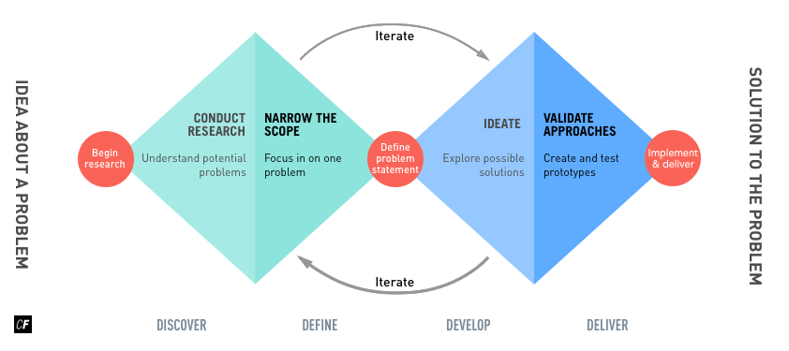
Using the Double Diamond Strategy

Slide 3
List of possible problems
User don’t know how to excess the application
How to ask the questions and how to reach the expert
A confusing user interface containing too much information or illogical navigation
Lack of trust on Expert, before taking advice
Feel to pay an adequate amount of fees for advice
Unable to solve the issue by expert or user became unhappy by the provided service

Slide 4
Problem Statement
Our expert app users need a way to find off the Pre-natal and post-natal yoga expert, while pregnancy and after pregnancy because they want to practice the yoga at home with their peace of time and comfort.
We will know this to be true when we see how many women's are using our app to find yoga expert of their choice and get the advice or classes through video calls, without compromising with time and place.

Slide 5
Possible Solutions
“An app that allows women to find Yoga expert during pregnancy or for new moms to get back to into the shape.
These expert advice are priced affordably and can be done through virtually i.e. video calls or textual.
The interface will be simple and totally focused on prenatal and postnatal yoga expert guidance, removing all other distractions and offerings.”

